Slide 1

Embracing Spatial Awareness For Reliable WiFi-based Indoor Location Systems
Jingao Xu*, Zheng Yang*, Hengjie Chen*, Yunhao LIu*^
*School of Software, Tsinghua University
^Michigan State University
10.11 in Chengdu, China
Notes:
[START]Thank you for the introduction, and hello everyone
Today I’m going to talk about our work
Embracing Spatial Awareness For Reliable WiFi-based Indoor Location Systems

Slide 2
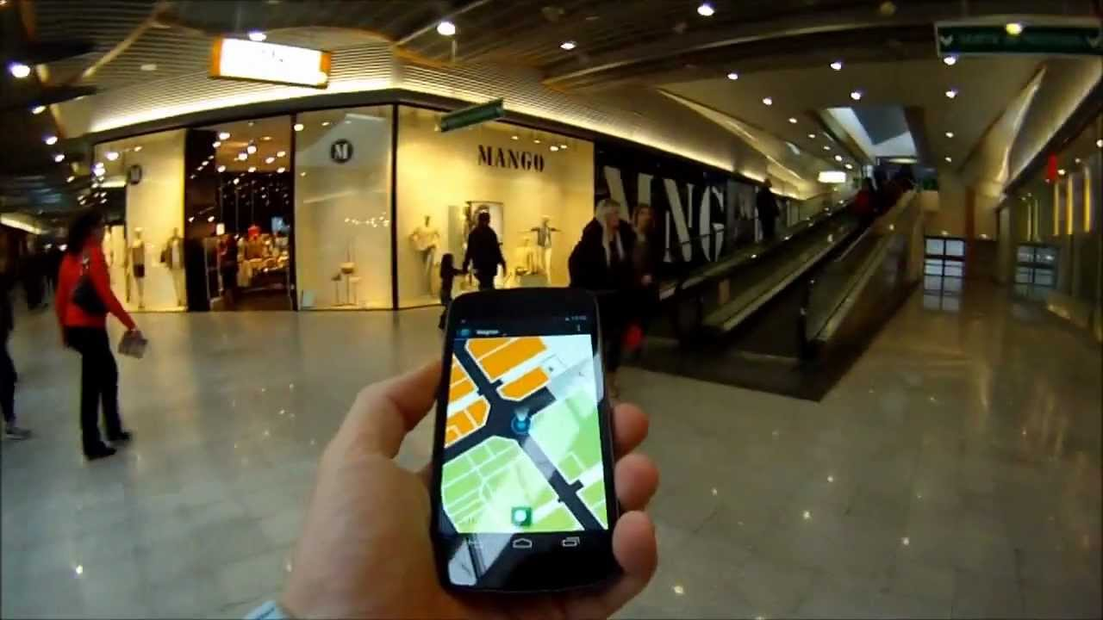
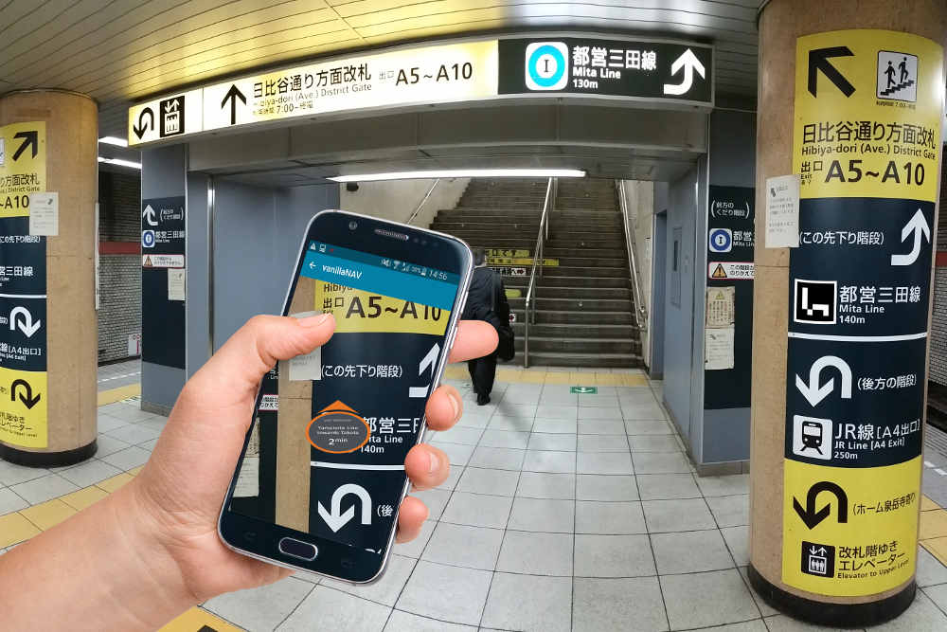
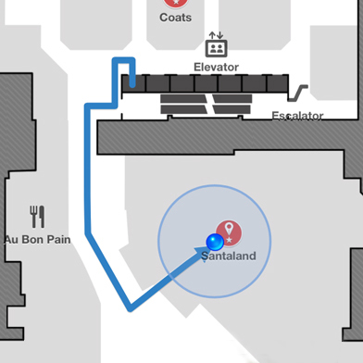
Motivation
Various location-based ubiquitous applications.
And locating with Wi-Fi is superior in
Ubiquitous: Almost everywhere installed infrastructure.
Low-cost: Off-the-shelf Wi-Fi devices.
Non-invasive: not required to wear/carry any special devices.
Indoor Location
Navigation
Mobile Tracking
Notes:
[START]The proliferation of various location-based ubiquitous applications fosters the demand for accurate localization services to be available everywhere, such as indoor location, indoor navigation and user’s mobile tracking.
Numerous techniques have been developed during the past decades based on WiFi, RFID, visual images and acoustic signals.
[CLICK]Among various approaches, WiFi fingerprint-based indoor localization has become one of the most attractive solutions due to WiFi devices are ubiquitous, cheap and does not require user to wear any devices.

Slide 3
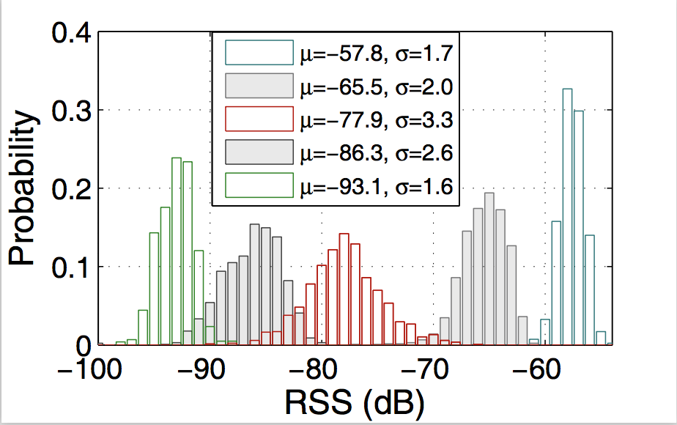
Major Problems
The RSS bias is large, usually >10db
No matter whether the AP is strong or not
Spatial ambiguity and Temporal instability
RSS bias over time
Notes:
[START] But the methods just use WiFi RSS fingerprint frequently yield large errors in practice.
One major root cause of the locations errors in RSS fingerprinting is the uncertainty of WiFi signals, just as shown in the left figure, we collect about 1500 RSS samples of different Aps and illustrate the RSS distributions of 5 Aps with diverse average RSS values, the RSS bias is very large whether the AP is strong or not.
[CLICK] Evidently, they may induce two aspects of severe influence: spatial ambiguity and Temporal instability.

Slide 4
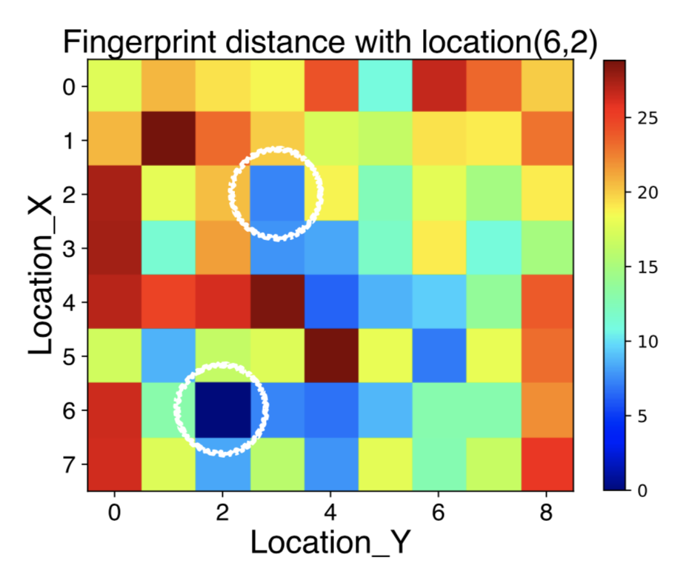
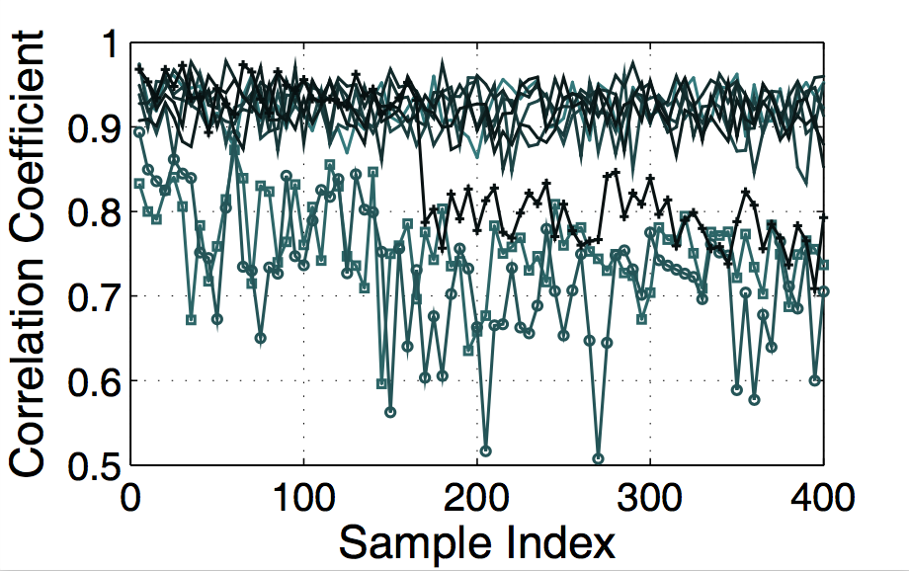
Major Problems
One fingerprint might be similar to those from two or more quite distant locations
Mismatch & Degrade the performance of original fingerprint database!
Fingerprint spatial ambiguity
Re-collected fingerprints from same location can’t match with initially fingerprint
Fingerprint temporal instability
Notes:
[CLICK] The spatial ambiguity means one fingerprint might be similar to those from two or more quite distant locations, rendering fingerprints over different locations become indistinguishable
[CLICK] Temporal instability means fingerprint of a location observed at one instant does not match the initially collected training fingerprints from the same location.
[CLICK]To conclude, both issues can lead to severe fingerprint mismatches and thus impair the localization accuracy and reside as two long-standing yet inevitable problems of conventional RSS fingerprints.

Slide 5
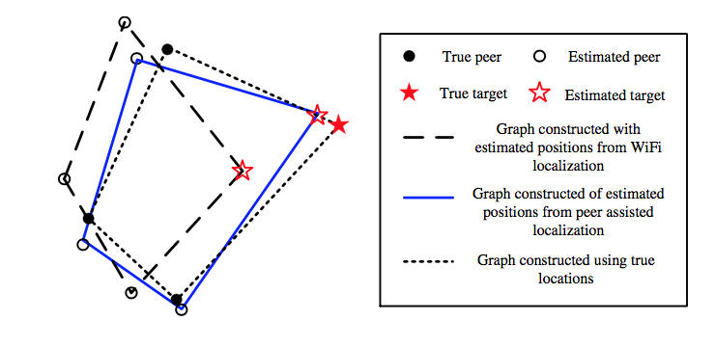
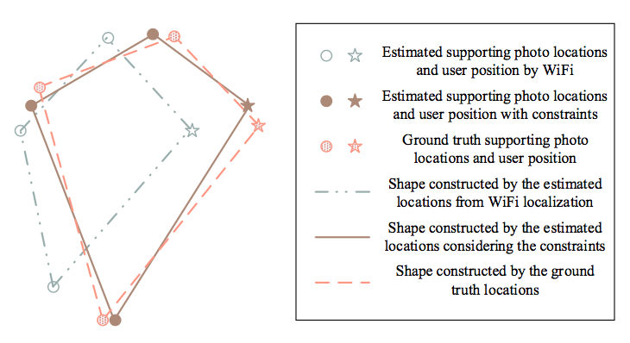
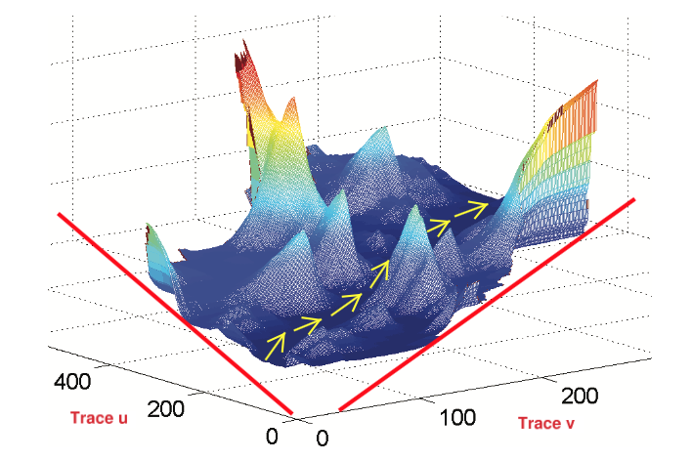
Existing Arts
Acoustic, Mobicom ’12
Argus, Ubicomp ’15
Followme, Mobicom ’15
While achieved better accuracy, these solutions degraded the delightful ubiquity and induce additional costs
Notes:
To solve the above two major problems, a bunch of works on indoor localization have been published in recent years, the key insight of these works can be divided into two parts.
The first part relay on additional sensors including visual images, acoustic signals and magnetic signals, these works achieve high level accuracy,
[CLICK]however they degraded the delightful ubiquity and induce additional system costs, for example, users need to heavily take pictures or cooperate with multiple peers for localization.

Slide 6
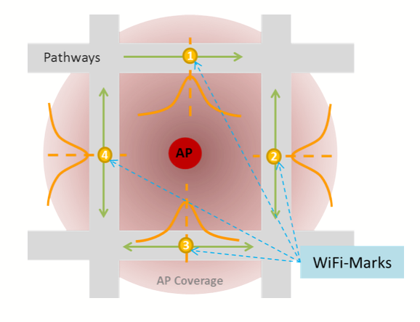
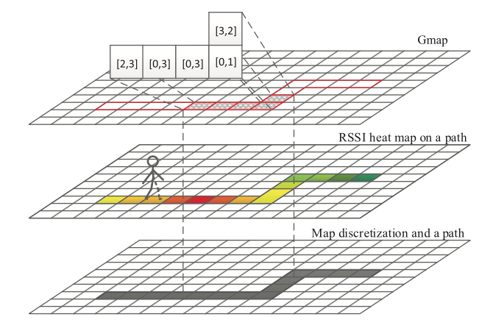
Existing Arts
Walkie-Markie, NSDI’13
GIFT, TIE ’16
Need a path and continuous fingerprints, can’t work when user is static!
Notes:
The second part consider the RSS changing trend when users are walking and collect continuous fingerprints, although these methods don’t need special hardware and achieve a more robust localization system,
[CLICK]however, they need a path and can’t work when user is static, moreover, the input of the system is continuous fingerprints which also induce system latency.

Slide 7

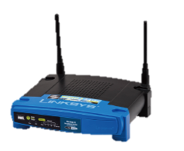
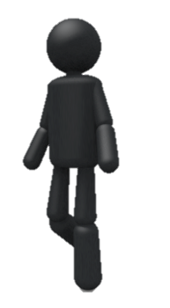
Problem Statement
Accurate localization using RSS fingerprint.
Overcomes spatial ambiguity & temporal instability using only Wi-Fi signals.
Without any additional system costs
Notes:
Unlike the existing arts, our goal is to overcome spatial ambiguity and temporal instability using only wi-fi signals and without any additional system costs.

Slide 8
Problem Statement
Additional information
Gain With Pain
High precision
Mitigate spatial ambiguity
Ease temporal instability
Induce system cost
Bring many restrictions
Special hardware
Gain Without Pain
A new form
Notes:
All in all,
[CLICK]the above methods are Gain with Pains,
[CLICK]which means although mitigate RSS fingerprint’s spatial ambiguity and temporal instability,
[CLICK]they induce system cost and bring many restrictions to users and sometimes need special hardware because they must use [CLICK]additional information.
[CLICK]But in our paper, we design a novel form based only on traditional RSS fingerprints and don’t need any extra information, which means our methods Gain without pains.

Slide 9
Key Insight
The spatial relationships of multiple RSS fingerprints from neighbouring locations would be more robust than individual RSS fingerprints from one single location.
5db
-60db
-65db
Original Power
8db
Adjusted Power
-68db
-72db
4db
Notes:
The key insight of the new form is that the spatial relationships of multiple RSS signals from neighbouring locations would be more robust than individual RSS signals, for example, if some AP adjusts its transmission power, the RSS values perceived at multiple neighbouring locations would be all affected at a same level
Just as an example, an AP transmit its power at a high level and a low level, a same pair of nearby locations’ RSS value is as shown in the figure
[CLICK] The RSS bias is 8db which is too large and may cause temporal instability
[CLICK] But the bias about the RSS value between the nearby location is 5db and 4db, which is same although the change of the AP’s transmission power

Slide 10
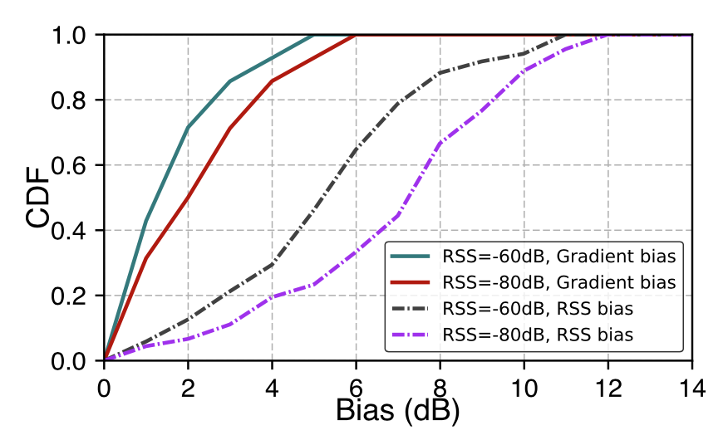
Key Insight
The spatial relationships of multiple RSS fingerprints from neighbouring locations would be more robust than individual RSS fingerprints from one single location.
Leverage Spatial Gradient
Notes:
As shown in the CDF figure, we collect and re-collect the RSS fingerprints at the same location a day before and after, although the RSS bias from the same locations is large, the RSS Gradient bias which means the bias between a location and its nearby location’s RSS difference is smaller.
So we can leverage the spatial gradient as a new stable form

Slide 11
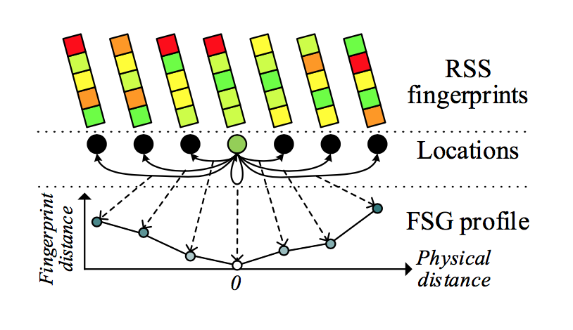
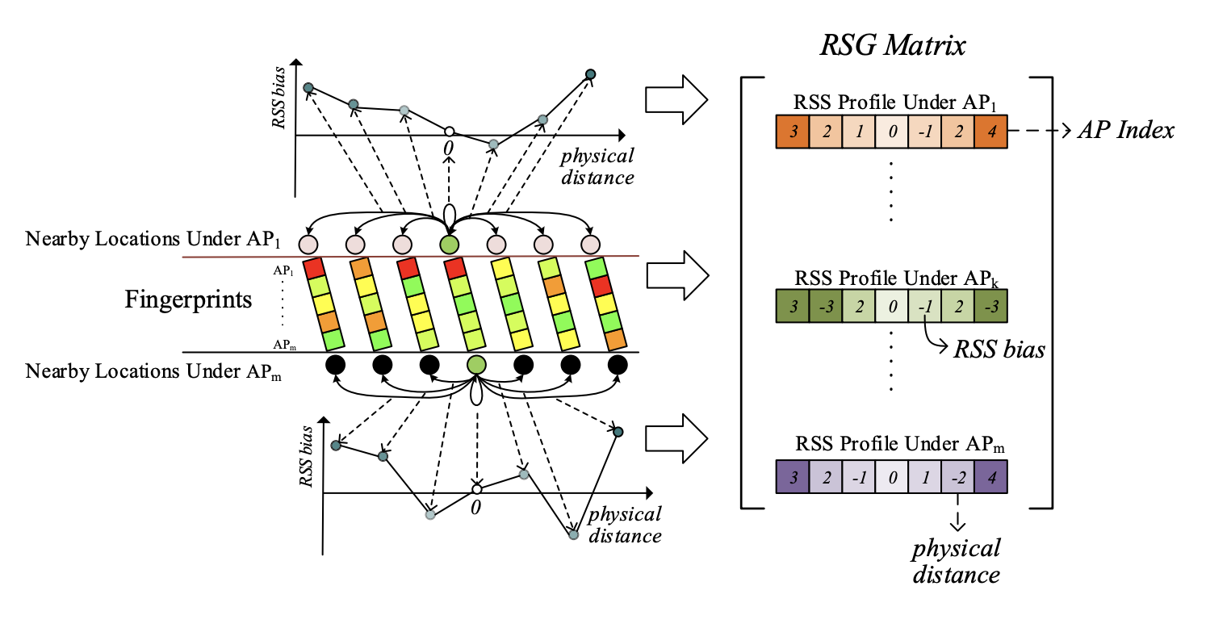
Our Work
A new form
ViVi: Accurate WiFi-based Localization using Fingerprint Spatial Gradient (Ubicomp’17)
ViViPlus: Embracing Spatial Awareness For Reliable WiFi-based Indoor Location Systems (MASS’18)
Fingerprint Spatial Gradient
RSS Spatial Gradient
Notes:
Our goal is to design a new form
[CLICK] In our previous work ViVi, we propose Fingerprint Spatial Gradient, which leverages the fingerprint similarity between nearby locations as a new form
[CLICK] And in this work ViViPlus
[CLICK] We decouple the traditional fingerprint and embracing spatial gradient directly on RSS values and make a breakthrough

Slide 12
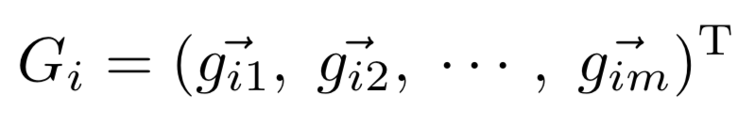
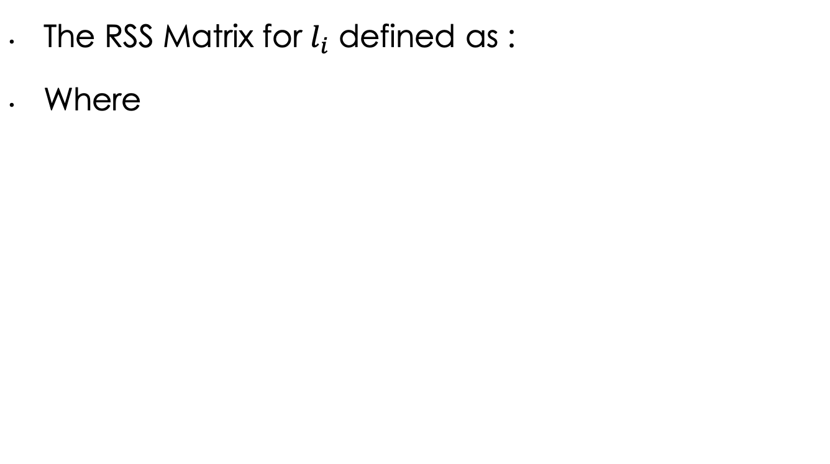
RSG Specification
The RSS Matrix for $l_{i}$ defined as :
Where
Notes:
Based on this insight, we propose and leverage the RSG form, as shown in the figure, for a specific location, the RSG Matrix describes the RSS similarity trend between the RSS of that location and several of its neighbouring locations.
For a specific location, each row represent one specific AP and each column represent the RSS bias between itself and its nearby location.
Note that we select two locations from the same physical distance, and put them at different sides from the current location, so in theory, bias in each row would first decrease to zero and then increase

Slide 13
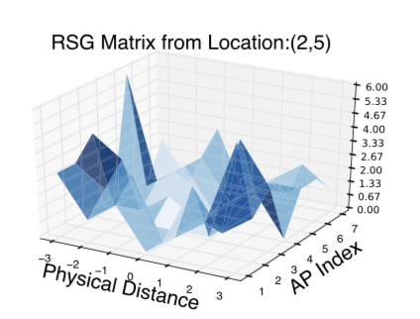
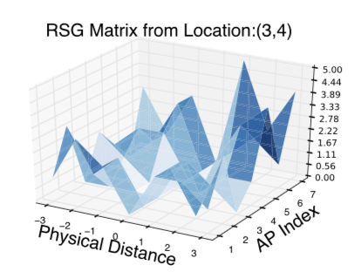
RSG Specification
Notes:
These are two RSG Matrix from different locations
Top is location (2,5)
Bottom is location (3,4)

Slide 14
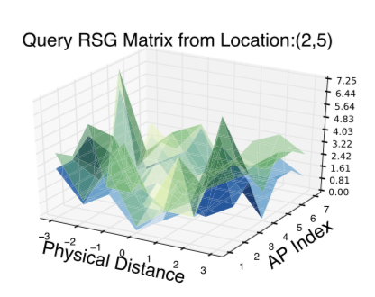
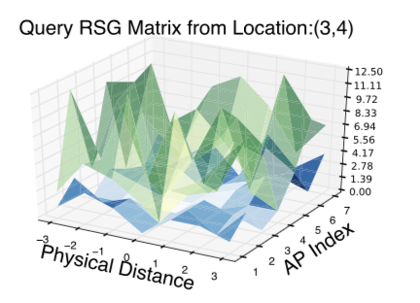
RSG Specification
Correct
Mismatch
Notes:
These are examples when we using RSG Matrix to compare
[CLICK] When the query fingerprint is from the real location, the query matrix will correctly compare with the matrix in database, just as shown in left bottom figure.
[CLICK] However, if the query fingerprint is not from the real location, the matrix will mismatch with each other just as shown in right bottom figure.
And now we need a method to calculate the similarity about the two matrix

Slide 15
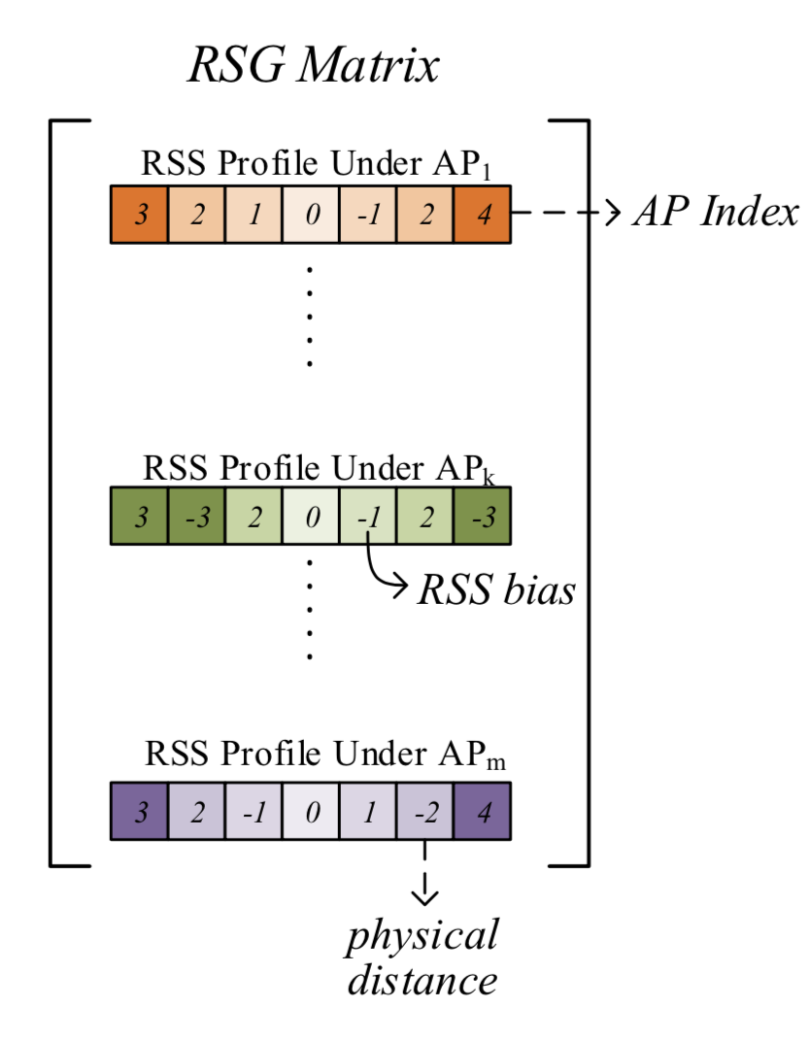

Comparing RSG
A Matrix?
A Figure?
Seem as a Matrix
Eigenvectors & Eigenvalues
Seem as a Figure
SIFT & SURF
Notes:
We can treat RSG as a matrix and even a figure
[CLICK] For a matrix, we can compare them using Eigenvector and Eigenvalues
[CLICK] As a figure, we can use traditional SIFT and SURF method to compare them.

Slide 16
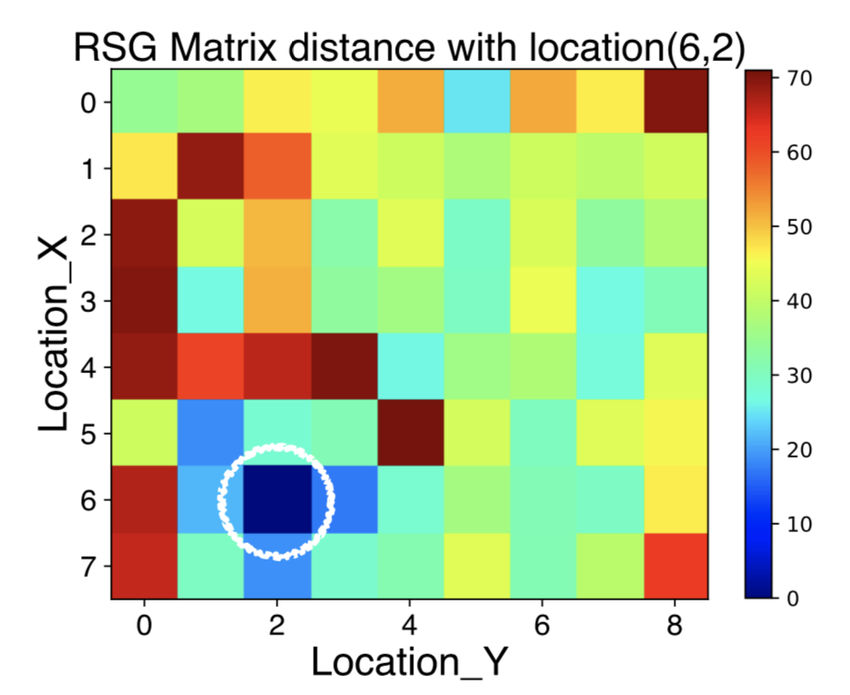
RSG Advantages
Leverage RSS Spatial Gradient
Temporally stable & Spatially distinctive
Certain spatial neighbouring relationships would be more stable
Spatially ambiguity
Spatially distinctive
Notes:
The advantage of the RSG is it exploits the spatial constraints among multiple RSS values from a set of elected multiple nearby locations .
As for the problem of spatial ambiguity, we compare the fingerprint distance and RSG Matrix distance between location (6,2) and other locations in the database and illustrate the result in two figures.
[CLICK] As shown in the left figure comparing the fingerprint distance, although the two locations plotted in white circles are about 6m away from each other, the fingerprint is similar with each other, which may lead to mismatch that we called spatially ambiguity.
[CLICK] But in the right figure, all the similar matrix locations are around the real location. Which is Spatially distinctive.

Slide 17
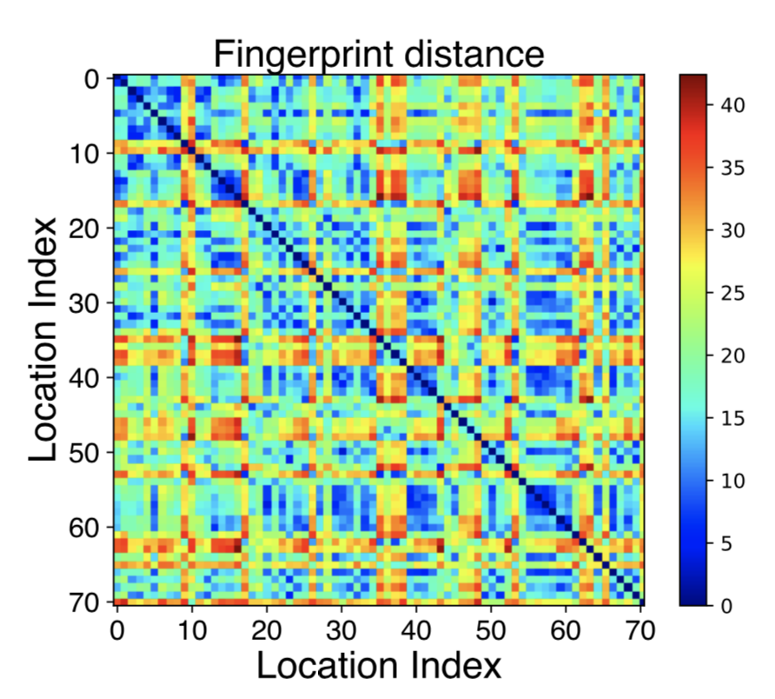
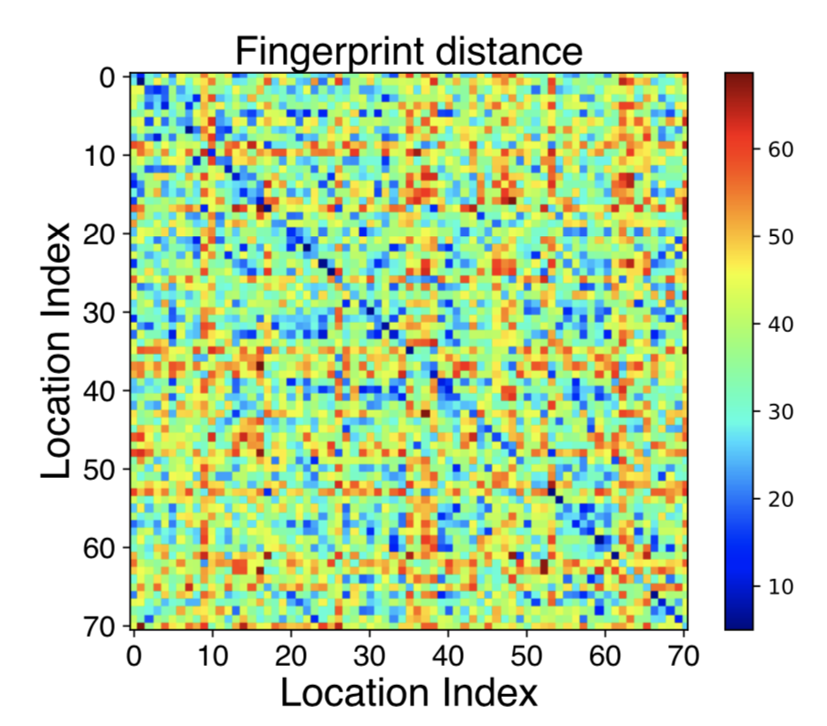
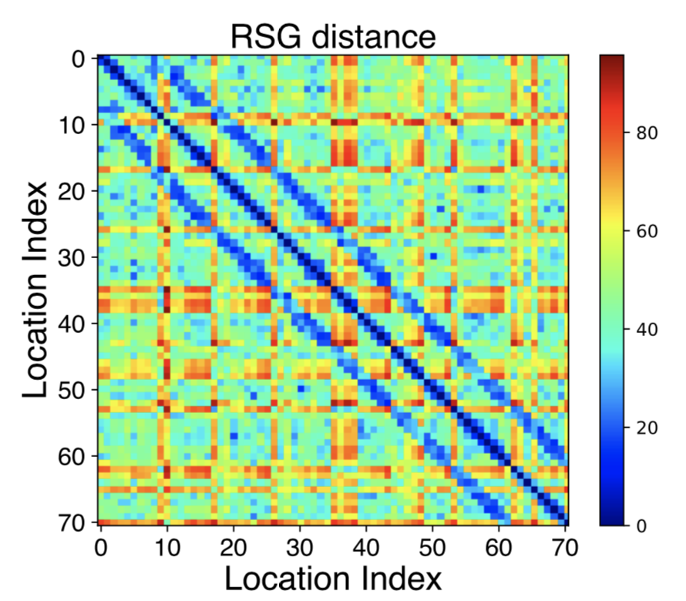
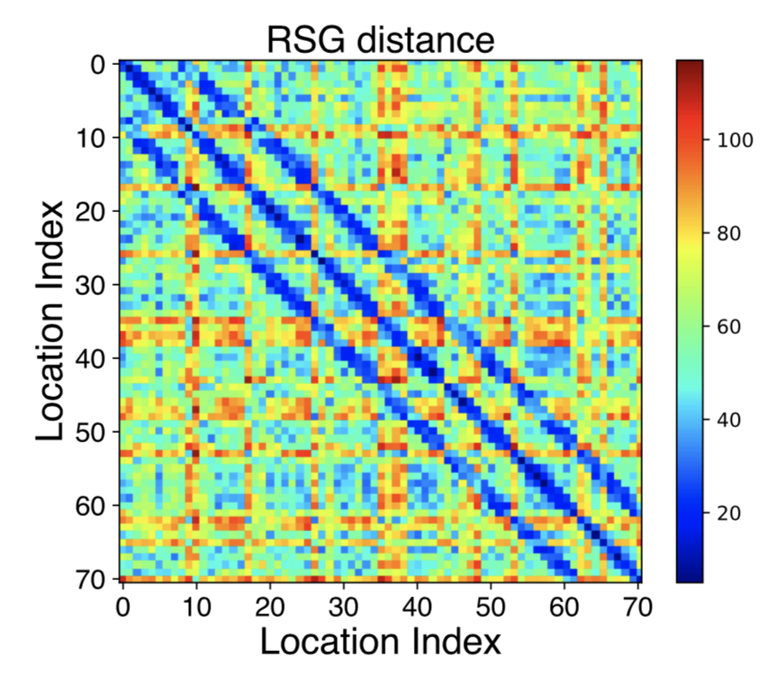
RSG Advantages
Leverage RSS Spatial Gradient
Temporal instability
One
Week
Temporal stable
Notes:
As for the problem of temporal instability
We re-collect the fingerprint database one week later and compare the two distance of each pair of locations in the database.
[CLICK] As shown in the top two figures, after a week, they are not similar with each other
[CLICK] But in the bottom two figures, although the fingerprint changes a lot, the distribution of RSG matrix distance is similar with that a week ago, which is temporal stable
We index the locations in a snake-like way, Diagonal(待爱跟偶) line is the location itself, and the nearly two lines are the neighbor locations

Slide 18
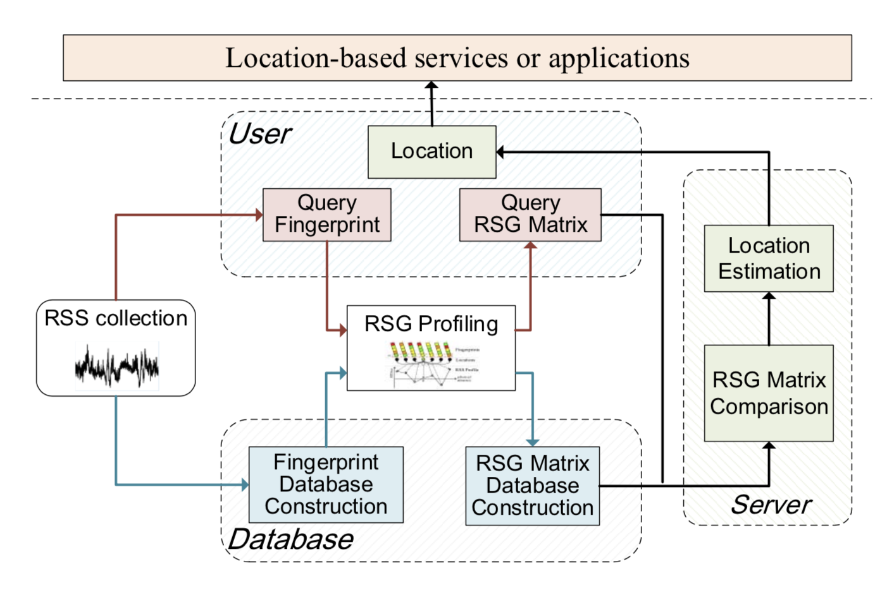
System Overview
Computed within
constant time
Inputs are no more than traditional fingerprints
Notes:
And we design a system named ViViPlus using RSG instead of traditional RSS fingerprints to indoor locate. Compared with other indoor localization systems
[CLICK]the system’s inputs are no more than traditional RSS fingerprints but it can mitigate fingerprints spatial ambiguity and temporal instability,
[CLICK]the core contributions lie in the introduction of an RSG profiling module along with an RSG comparison module, and the two modules can also be computed within constant time.

Slide 19
Evaluations & Results How much gains we can get without pains?

Slide 20
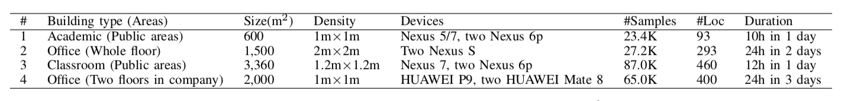
Experiment
5 Devices
Google Nexus 5
Google Nexus 6p*2
Google Nexus 7 pad
HUAWEI Mate 8 & P10
4 Experiment areas
Academic: 23.4k samples
Office: 27.2k samples
Classroom: 87.0k samples
Company Office: 65.0k samples
Experiment measurements
Each location 60 measurements
5 Baselines
Horus (Winet’08)
TW-KNN (Pervasive Computing’14)
KL-Div
GIFT (TIE’16)
ViVi (Ubicomp’17)
Notes:
We prototype ViViPlus on 5 different smartphones and conduct experiments in 4 different building with the implementation of five different state-of-the-art approaches as comparison, the data collection details are summarized in the Table. When collecting fingerprints for training, we employ a typical sampling frequency for 1HZ and at each location we collect 60 fingerprints and use the average fingerprint as the representative

Slide 21
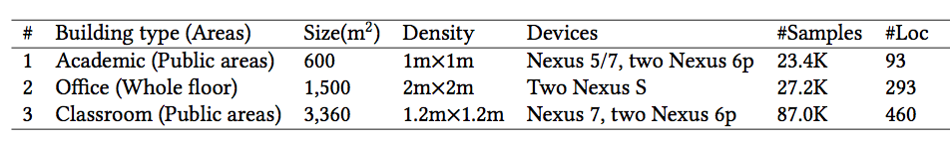
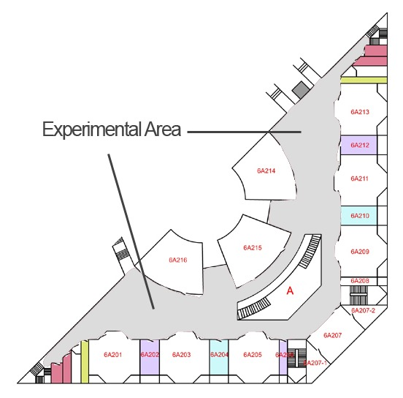
Experiment
Office
Academic
Classroom
Notes:
These figures show the floor plans of different experimental areas.

Slide 22
Performance in different areas
Average accuracy in three areas: 3.3m,4.3m,3.8m
Smaller areas yields better accuracy
Different areas
Notes:
We evaluate the performance in three different experimental floors as illustrated before. As seen ViViPlus yields an average accuracy of 3.3m in the academic building, 4.3m in the office building and 3.8m in the classroom building. The result also demonstrate the denser sample locations in smaller areas yield better accuracy, which confirms with various previous works

Slide 23
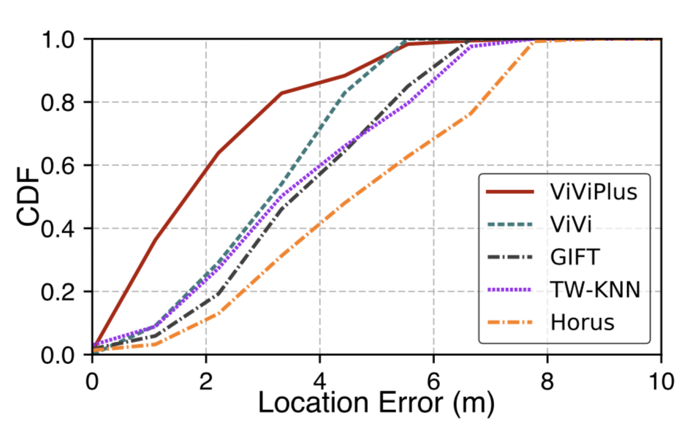
Performance comparison
Average accuracy outperforms ：
Horus by 48.3%
GIFT by 36.9%
TW-KNN by 35.2%
ViVi by 27.9%
Different methods
Notes:
As shown, ViViPlus achieves the best performance among all comparative systems.
The encouraging performance gains are achieved without introducing any extra costs. Further improvements could be obtained by combining more enhanced techniques, like particle filter and fusing more sensor data

Slide 24
Performance comparison
System latency(Average time delays for 1000 queries):
ViViPlus: 0.37s per query
ViVi: 0.33s per query
Horus: 0.28s per query
TW-KNN: 0.77s per query
GIFT: 0.84s per query
Notes:
We randomly select one query fingerprint from a set of queries and ViVi returns the locate results. Then we average the time delays for 1000 such queries. For each comparative method, we run the same process and calculate the average running time. The average query delay of ViVi is similar with or shorter than previous works

Slide 25
Conclusion
A new form based on RSS values
An underlying spatial properties of nearby fingerprints
More stable and distinctive than the original RSS fingerprints.
Present a system ViViPlus to incorporate RSG
Gain without the pains of resorting to additional information or restrictions or vulnerable RSS model assumptions.
Median accuracy outperforms 5 state-of-the-art approaches by more than 20%
Can easy combine other signals or methods to realize mobile tracking (CV, IMU, etal)
Notes:
So, that’s out work
The contributions are from two parts:
First, we design a new form RSG, RSG is more stable and distinctive than the original RSS fingerprints
Second, based on the new form, we design a system named ViViPlus, the system’s input is no more than traditional fingerprints but can get better accuracy, that is what we say a “Gain without pain” localization system!

Slide 26

Demo
Notes:
So, that’s out work
The contributions are from two parts:
First, we design a new form FSG, FSG is more stable and distinctive than the original RSS fingerprints
Second, based on the new form, we design a system named ViVi, the system’s input is no more than traditional fingerprints but can get better accuracy, that is what we say a “Gain without pain” localization system!

Slide 27
Thanks!
Q&A
Jingao Xu
Tsinghua University
xujingao13@gmail.com
Notes:
[Start]. That's all. Thanks for listening.

Slide 28
Challenges
How to select the nearby points set from the single location to generate the most useful RSG?
How to compare the similarity between two RSG?
Notes:
Now, we have define and understand the advantage of the RSG, there are still two challenges remains there, first, to construct each locations’ RSG matrix, we need to consider the fingerprints from the nearby locations, so how to select the most useful nearby points?
Second, in the RSG comparing stage, how to compare two RSG matrix?

Slide 29
Challenges
How to select the nearby points set from the single location to generate the most useful RSG?
How to compare the similarity between two RSG?

Slide 30
Profiling a Reference Location
Obtaining the most stable and distinctive RSG
Minimizing Local Gradient (MLG)
Maximizing Global Gradient (MGG)
Optimizing Spatial Stability (OptSS)
Notes:
The principle we select the nearby locations is to make the RSG matrix more stable and distinctive
We propose three methods in our previous work ViVi, and find for ViViPlus, the Optimizing Spatial Stability method is the most useful.

Slide 31
Challenges
How to select the nearby points set from the single location to generate the most useful RSG?
How to compare the similarity between two RSG?
Notes:
Now, we have define and understand the advantage of the FSG, there are still three challenges remains there, first, to construct each locations’ FSG profile, we need to consider the fingerprints from the nearby locations, so how to select the most useful nearby points? Second, in the FSG comparing stage, how to compare two FSG profiles? Last but not the least, when a user upload just one single query fingerprint, how to locate according to the fingerprint?

